Slide 1

SOFTWARE TEST PLAN
NAME=SRUSHTI MUDHOLKAR
ROLL NO.=IT-2K19-60
TOPIC=SOFTWARE TEST PLAN OF CUSTOMER COMPLAINT MANAGEMENT SYSTEM

Slide 2
For your selected system, prepare a plan using the following:·
Consider a critical use case scenario for your system·Identify the software components (units or classes) which are essential for that functionality
Unit testing
oSpecify what tests you would include for the identified components
oBe specific with reference to your system, please do not write general theory

Slide 3
Integral Testing
oSpecify the approach you would use to combine the units and test them in an incremental manner, till all the units relevant for a scenario are covered .Select and justify your preference for top-down or bottom-up
oJustify your selection of units for combining and testing (e.g. why unit1 and unit5 are being selected first)

Slide 4
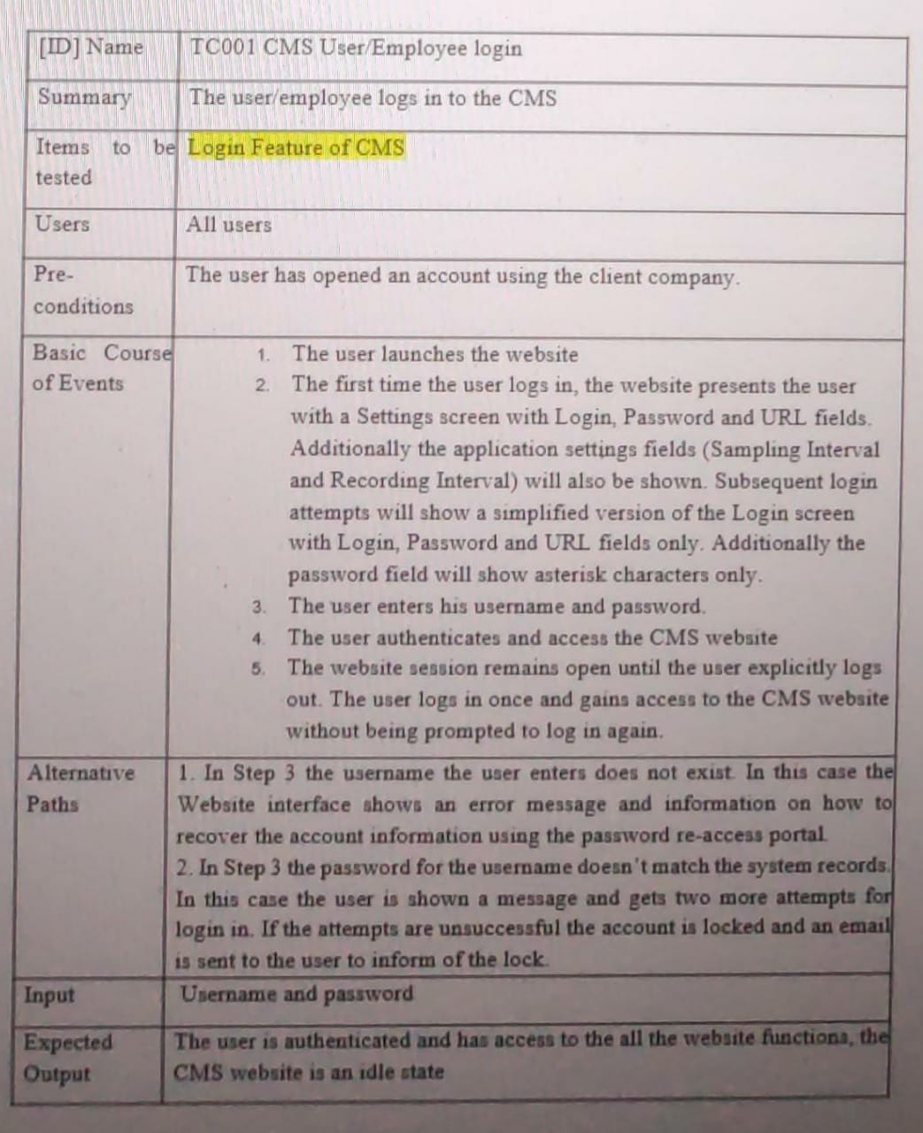
Unit Testing
Test Cases

Slide 5
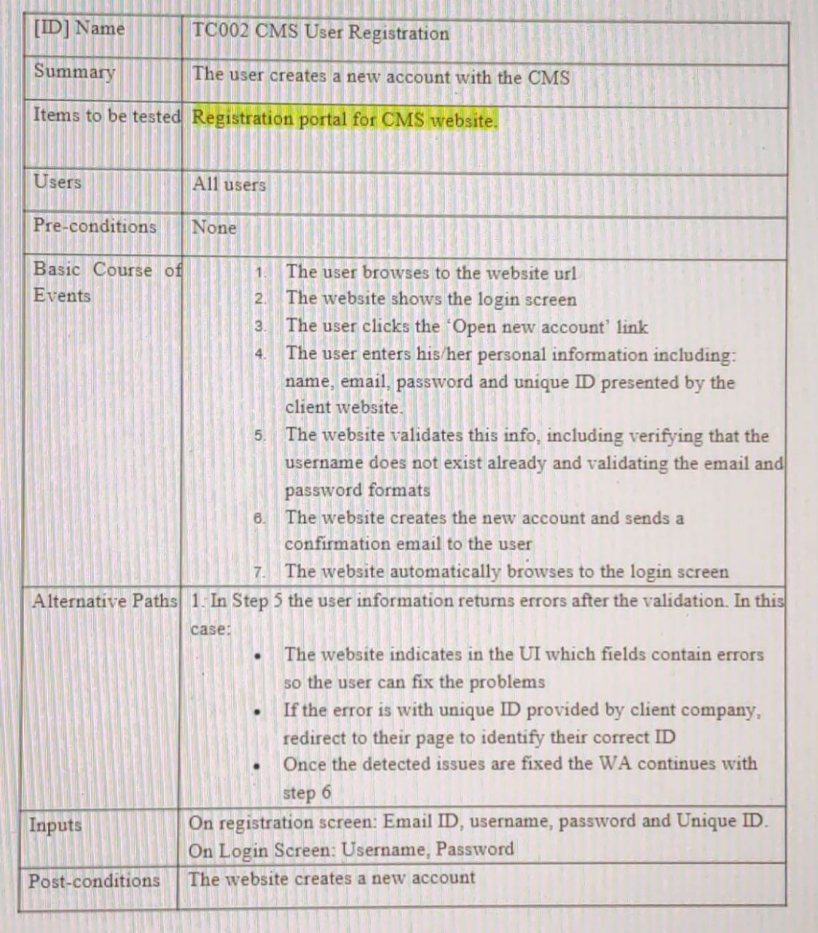

Slide 8
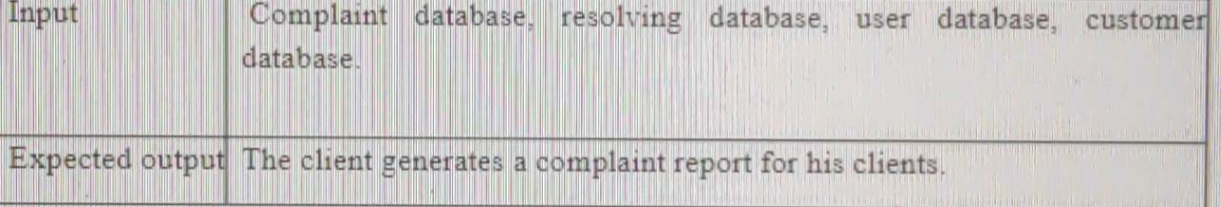

Slide 9
Integration testing
The purpose of integration testing is to expose faults in the interaction between integrated units. We have chosen top-down approach for testing the interface between two software units or modules for our software as Fault localization in this method is much easier and it gives an early possibility to obtain a rough prototype for the product. Not just this, systems can be tested simultaneously thus saves a lot of time.

Slide 10
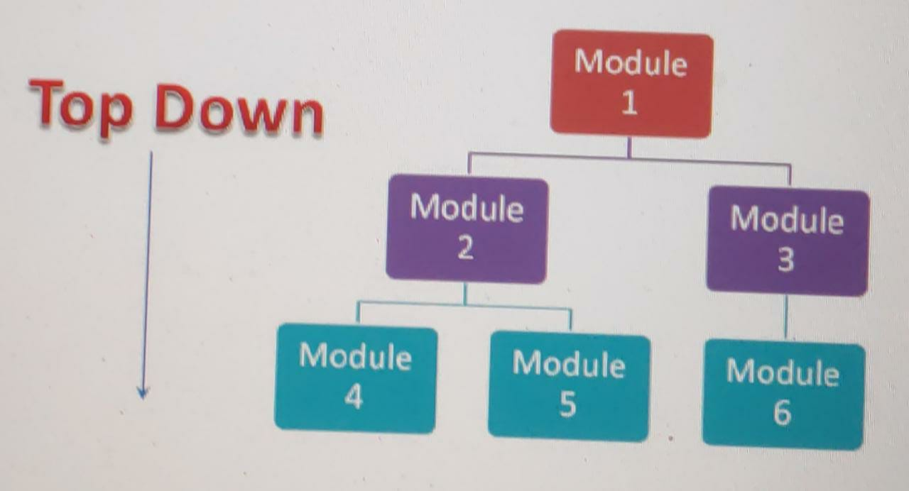

Slide 11
Test case objective | Test case description | Test case expected result
Check the interface link between complaint registration and database | Enter the complaint details on the option at the dashboard and then click on submit complain | The new complaint should have been added in the database in the pending or new complaint table without overwriting any earlier data
Check if the view complain button is working well with the database on the employer’s dashboard | On the employer’s dashboard click on view new complains | The newly registered complaint should be displayed on the employer’s dashboard from the database

Slide 12
Test case objective | Test case description | Test case expected result
Check the integration of the chatbot feature between employers and customers dashboard | Try clicking on the chat button and sending one or two texts | Chats should be visible perfectly on both sides
Checking the integration of the report uploading button with the database | Click on upload solution report on employers dashboard and try uploading a file | The file should be successfully stored in the database at the correct complaint id
Checking the integration of the view report button on the customer’s dashboard | Click on view solution on the dashboard | The correct report should be displayed on the dashboard to the user
Download report button | Click on the download solution report | The report should be downloaded on the user’s device which was earlier displayed from the database

Slide 13
Test case objective | Test case description | Test case expected result
Account setup linked with the database | Try adding, editing or deleting the information at the setting up account page on the dashboard | Check if the details editing, added or deleted are correctly getting updates both in the database and the dashboard
Check the interface link between login and dashboard | Enter the credentials and click on the login | To be corrected directed to the dashboard
Check the interface link between registration, database and login page | Register as a new user and then click on the register | The registration details to be saved in the database and the user should be redirected to the login page

Slide 14
In the table the high priority cases are tested first and as going down the table the low priority cases are considered for testing.

